Slide 1




Capitalizing on takeaways, perspectives and lessons learned from N4G Paris
June 2025

Slide 2
OUTLINE
INTRODUCTION – 1 slide
APPROACH – 1 slide
EXECUTIVE SUMMARY – 1 slide
N4G PARIS KEY TAKEAWAYS – 5 slides
IMPROVING FUTURE N4G SUMMITS – 3 slides
WHAT’S NEXT– 2 slides
LESSONS-LEARNED ON THE ORGANIZATION– 9 slides

Slide 3
INTRODUCTION
N4G – the global nutrition pledging event taking place every 4 years – was held in Paris at the end of March 2025.
In May and June 2025, the three organizations that supported the N4G Paris International Governance and its Secretariat (the SUN Movement Secretariat, Nutrition International, UNICEF) collaborated to conduct a lessons learned exercise.
Purpose:
1. Consolidate key takeaways and perspectives on N4G Paris from the nutrition community
2. Capture good practices and suggestions for future N4G hosts, for continuous learning.
Outputs:
A public slide deck [this document] & executive note
A note for future organizers– not for public diffusion – with operational details

Slide 4
APPROACH
What it is: a rapid exercise with a light methodological approach to capture the key takeaways, perspectives, good practices and suggestions for future N4Gs as perceived by the community.
What it is NOT: A systematic review / an evaluation of N4G
The data was collected from stakeholders who took part in N4G organization through:
An open-ended online questionnaire (18 respondents)
5 small group discussions with 48 participants.
Respondents were not selected as to form a representative group of stakeholders.
While efforts were made to validate the findings presented here through group discussions and to introduce nuances to reflect different views, they should be taken with caution and may not reflect the diversity of perspectives.

Slide 5
EXECUTIVE SUMMARY
Key Takeaways
N4G Paris successfully mobilized new significant political and financial commitments for nutrition
N4G Paris fostered the engagement of a broad, high-level, and diverse group of stakeholders
Paris continued strengthening the N4G process
Improving Future N4G Summits
Greater mobilization of non-SUN countries
Consultations to rethink private sector engagement
Quantification of nutrition-sensitive investments
Space for announcing commitments
Cover further the topic of accountability
Joint statement as a call to action
What’s Next
Clarifying the "what's next?"
Reflecting on sustaining momentum between summits
Addressing the need for leadership and continuity
Lessons-Learned on the Org.
Start early
Build an inclusive and participative international governance structure
Plan strategically the mobilization of commitments
Design the Summit to maximize engagement

Slide 6
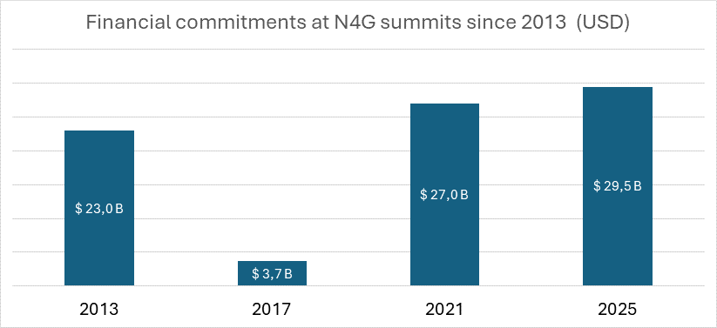
N4G PARIS KEY TAKEAWAYS
N4G Paris successfully mobilized new commitments for nutrition
Mobilization regarded as a significant success: Despite a challenging global context and the high benchmark set in Tokyo, N4G Paris successfully mobilized commitments, reaching a similar number of commitments than in Tokyo and with financial pledges exceeding most stakeholders' expectations.
USD 29.5 billion as of 11 April 2025 (Summit Compact Annex)

Slide 7
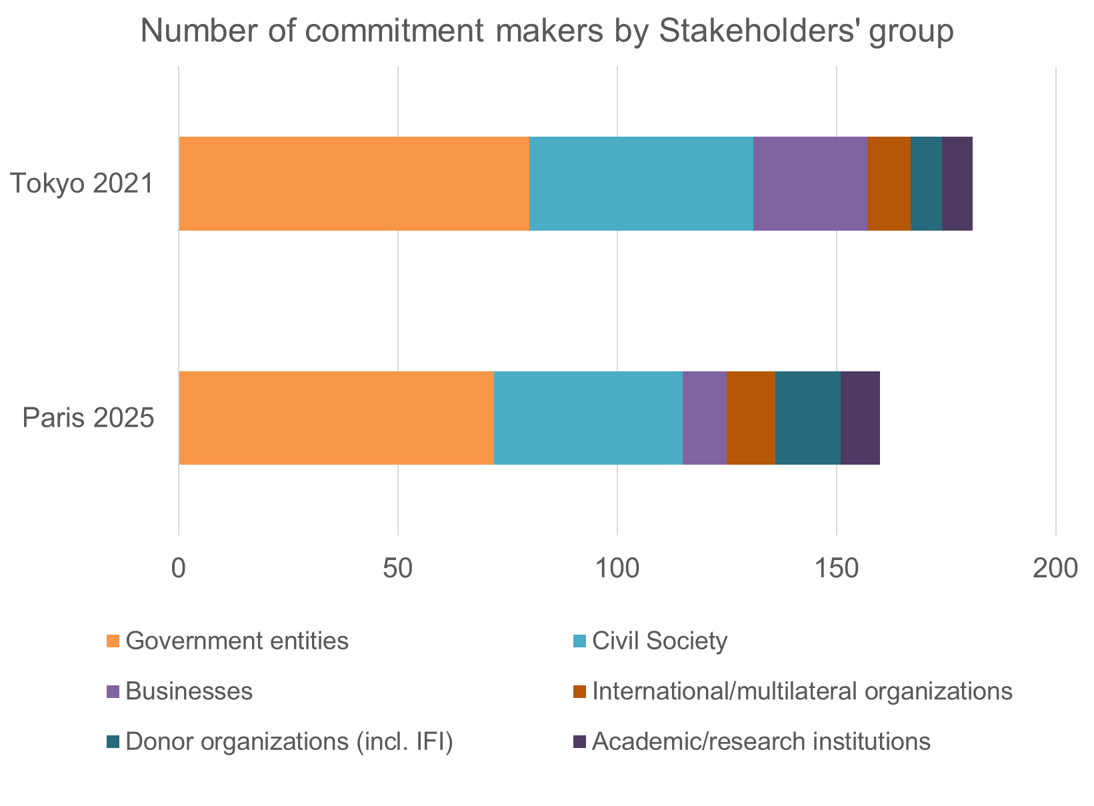
N4G PARIS KEY TAKEAWAYS
N4G Paris successfully mobilized new commitments for nutrition (Cont.)
The breakdown of commitments between stakeholders' group is overall quite similar to N4G Tokyo.
The significant political and financial commitments and resilient outlook of Low and Lower-middle Income Countries (LICs/LMICs) was notable.
More donor organizations have committed (including public development banks and foundations)– reflecting the strong financial mobilization
Less businesses have committed, which may be related to stricter Principles of Engagement

Slide 8
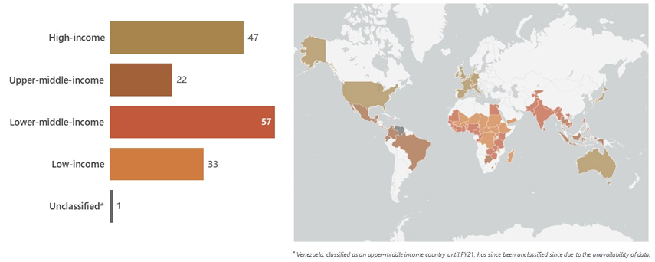
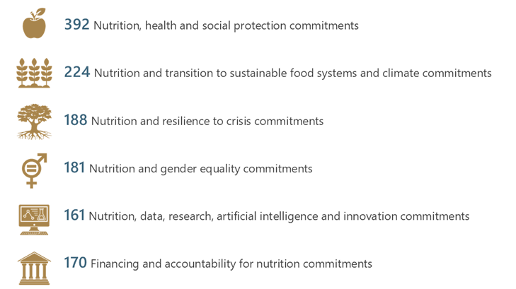
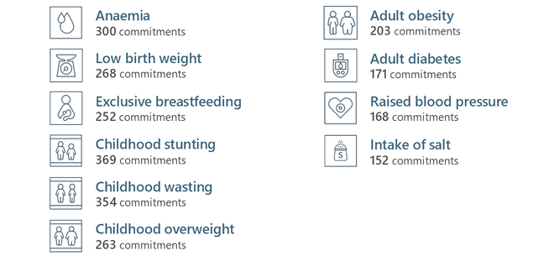
N4G PARIS KEY TAKEAWAYS
# commitment-makers per income category
More analysis of N4G Paris commitments is available in the Statement Annex
# commitments per summit theme
# commitments per global target

Slide 9
N4G PARIS KEY TAKEAWAYS
N4G Paris fostered the engagement of a broad, high-level, and diverse group of stakeholders
N4G Paris successfully convened broad and high-level participation: The Summit brought together executives and high-level officials from 211 delegations (including from 106 national governments). N4G Paris engaged and convened state actors from diverse contexts and income level to discuss malnutrition issues holistically, with the vision that all countries are affected by at least one form of malnutrition. It offered an excellent networking platform for nurturing partnerships and collaborations.
The Summit came at a critical time to discuss major shifts in international development, including the evolving financing landscapes. Discussions during plenary sessions and round tables were meaningful and fostered learning, with concrete experiences from countries driving inspiration.
The launch of the Compact on Nutrition Integration underscored the willingness to address malnutrition through policy coherence and multisectoral action.
The engagement of the Civil Society and Youth representatives in the preparation and their active participation during the Summit, resulted in a joint declaration from the Civil Society and a call to action by the Youth.
The private sector engagement led to a Paris Declaration on Business & Nutrition 2030 and call from investors for more disclosure on nutrition by Food & Beverage companies.

Slide 10
N4G PARIS KEY TAKEAWAYS
N4G Paris strengthened the Nutrition for Growth process
Contributed to confirm N4G as a key international event for nutrition, and to create continuity between Summits by building upon the previous N4G events, particularly the Tokyo Summit, while adapting to the current context.
The continued use of the Global Nutrition Report’s (GNR) Nutrition Accountability Framework (NAF) strengthened this global mechanism to keep stakeholders accountable for their commitments to nutrition.
Commitment to a stocktaking meeting during the French G7 presidency is viewed as a valuable step to ensure ongoing dialogue, implementation and progress monitoring, and sustainability of outcomes, reinforcing N4G as an ongoing process rather than a standalone event.

Slide 11
IMPROVING FUTURE N4G SUMMITS
Participants in the lessons-learned exercise highlighted potential opportunities for improving future N4Gs for consideration by the next host:
Summit organization:
Find the right balance between high-level sessions, providing space to announce & highlight commitments and presenting a preliminary analysis of country and donor commitments.
Cover further during the Summit the topic of accountability for nutrition, as well as operationalizing integration across sectors and governance for nutrition.
Issuing a joint statement that is a call for action.
Commitment-making:
Explore avenues for greater mobilization of non-SUN countries, particularly domestic commitments from high-income and upper-middle-income countries.
Conduct consultations to rethink private sector engagement (mainly outside of the official event at N4G Paris) while maintaining strong Principles of Engagement.
Define more explicitly the methodology for quantifying financial commitments for nutrition-sensitive (or “integrated”) investments.

Slide 12
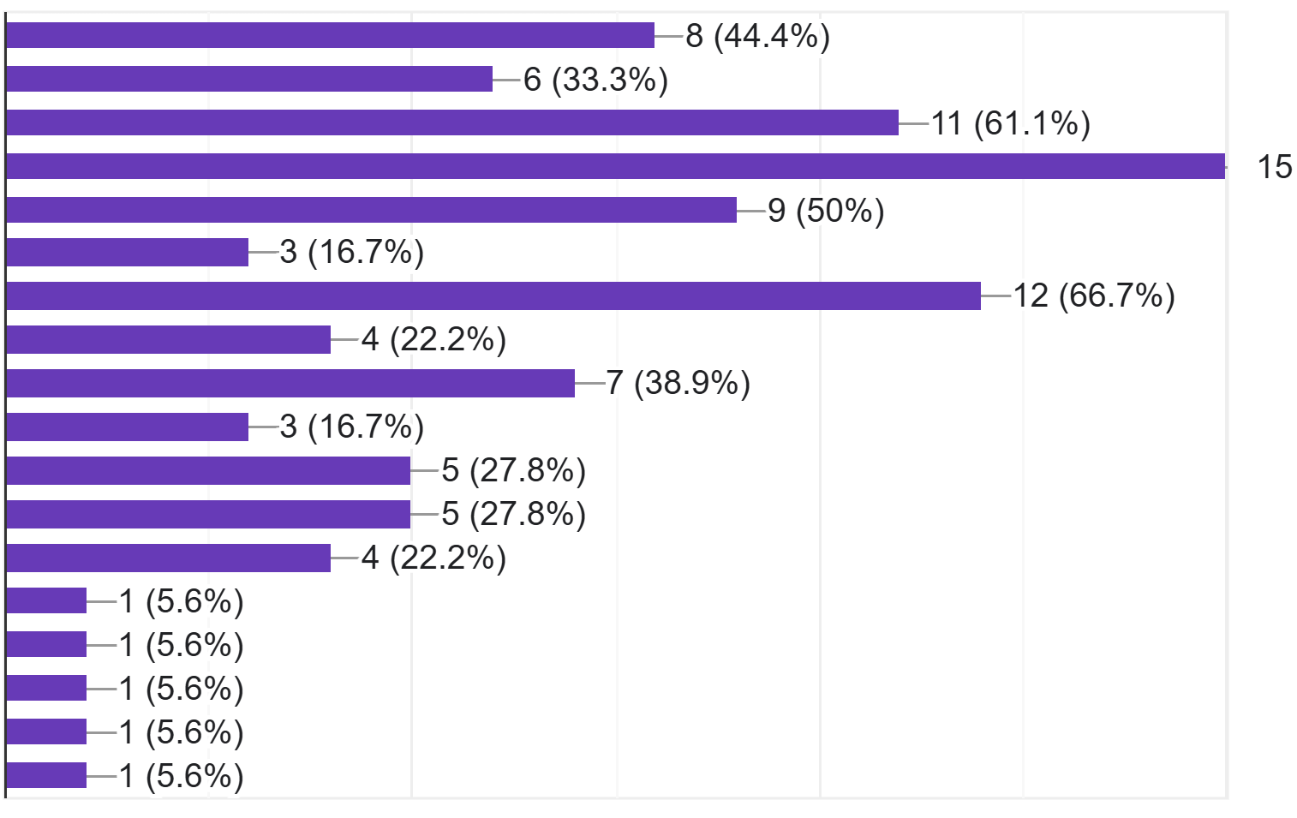
Responses to the question in the survey “What thematic areas would you recommend for the next Summit (up to six choices possible, please select the top priority themes)”
Nutrition and Health
Nutrition and Social Protection
Nutrition and Transition towards Sustainable Food Systems
Financing for Nutrition
Accountability for Nutrition
Gender and Nutrition
Integration of Nutrition across sectors
Nutrition and Resilience to Crisis
Governance for Nutrition
Nutrition and Climate Change
Innovation for Nutrition
Research, Monitoring, Evaluation and Learning for Nutrition
Multi Stakeholder Partnerships for Nutrition
Other (Local solutions for sustainability)
Other (Merge integration and multi-stakeholder partnerships)
Other (National policies, guidance and laws for better nutrition)
Other (Nutrition and Migration)
Other (Private sector for Nutrition)
(83,3%)
(Top 6 responses in bold / Top 3 in red)

Slide 13
Despite the time pressures and incredibly challenging political context, the Summit achieved its goals in terms of mobilizing diverse commitments exceeding Tokyo. Elevating this to Presidential level was an incredible outcome and achievement.
There is huge value in bringing together the political and technical aspects of nutrition. While there are regular meetings of nutrition scientists and programme directors, such a high-level engagement at Ministerial level is rare and extremely important.
Great energy when stakeholders meet in-person, despite difficult conversations and current funding environment. Important for nutrition to be in the agenda, as a cross-cutting topic as well.
Despite the current situation and scarcity of resources, there has been an increase in the financial commitments made to tackle malnutrition which reflects increased attention to nutrition as a cross-cutting priority area.
There is a sustained commitment for improved nutrition at global community and member states
Although very hard to do, an effort needs to be made to match donor/funding pledges, with country level needs.
The Summit itself needs to be more about announcing commitments, but more importantly about taking stock of the commitments they made at former summit and why they did not meet them
The Declaration should be more of an inspiring call to action with clear goals for the next Summit
Having the CSO Pavilion was crucial for hearing the different perspectives, collaborations, evolution of the nutrition sector over time.

Slide 14
PENDING QUESTIONS
Questions raised
Clarifying the "what's next?" to translate the momentum from Paris into tangible action and sustained accountability:
Establishing mechanisms for follow-up at country and global levels. Organizations can be tasked with continuing specific streams of work between Summits.
Matching donor pledges with country level needs.
Formalizing the process for regular progress reporting on commitments acknowledging that some countries may require technical assistance and that the NAF needs to be resourced.
Reflecting on sustaining momentum between summits (communications, convenings/stock taking moments), including in upcoming global events.
Addressing the need for leadership continuity, including reflecting on an institutional home for N4G to maintain engagement, preserve institutional memory and prepare groundwork before a host country gets on board.

Slide 15
There should be a process to review the progress of the commitment before the next N4G Summit. This will help to make course correction to attain the commitment goals
Important to not have big gaps between summits and that orgs are tasked with continuing the work in between.
Increase the frequency of communications and convening on N4G. Once every four years is not a recipe for momentum and accountability
I would suggest that there be a permanent secretariat that carries forward the overall organization from one Summit to the next and establish more continuity. (Possible options could be the SUN secretariat or UN Nutrition.) This secretariat would establish the overall governance structure. While the host country may make some changes to this structure, they should not be expected to create their own structure every time.
The Summit is critical for maintaining momentum on nutrition. While political realities pose challenges to the organization of the Summit, the global nutrition community needs to come together to ensure powerful summits are convened in the future.The future of nutrition is dependent on creating a more collective model for organizing and hosting future summits.
Olympics are typically hosted by upper-income countries. A separate selection process should be established for the leadership of the Summit, perhaps requiring that it be shared by a low-income and a high-income country.
Where is the institutional memory going to reside?

Slide 16
LESSONS-LEARNED ON THE ORGANIZATION
1. Start early
Effective organizational planning should start ideally at least 18 months prior to the Summit, as the mobilizing and preparing commitments requires significant lead time.
An early and official launch, supported by timely and targeted communications and invitations, is crucial for leveraging the energy and efforts from the nutrition community, including for high-level political advocacy and technical support.
Illustrative example of a potential timeline:
M-18 – M-12 : Formalize Governance, Develop Strategic Framework & Sensitization
M-12 – M-6 : Political Mobilization, Technical Guidance and Launch of the Registration platform
M-6 – M-1 : Peak Mobilization, Program Finalization & Logistics
M-1 – M+2 Summit Execution & Follow-Up
Establish Governance Structure
Finalize comprehensive Summit vision, strategic roadmap, and commitment guide.
Sensitization and awareness-raising. Official launch event organized a year ahead.
Encourage progress assessment of previous commitments to take place
Intensify High-level political mobilization.
Finalize practical guiding documents on commitments (such as thematic recommendations of commitments)
Develop communication strategy.
Launch commitment registration.
Peak mobilization: Conduct regular webinars / workshops /sensitize on the process and the recommendations.
Prepare the program. Select side events.
Prepare invitations and logistics. Issue invitations between 8 weeks to 3 months in advance (depending on stakeholders' type)
Communicate and provide regular updates to the community
Deliver Summit. Initial outcome documents (Declaration, summary of commitments) released by end of Summit or immediately after.
Post-Summit Analysis & Reporting
Lessons learned exercise

Slide 17
Aim to standardise the process as much as possible to save time each time with starting from scratch. Start the whole process 2 years before the summit, usually start is quite slow. But this way organisations involved can spread the work.
Start with full preparations at least a year in advance - ideally 1.5 years before, to set up and start meetings to shape Summit vision, roadmap and commitment guide. [...] Commitment mobilization should start by sensitization up to a year before - and with full commitment mobilization using the commitment guide starting 6-9 months before the Summit.
At least 12 months for the overarching vision and roadmap is needed, since it sets the parameters for all subsequent decisions.
There should be a meeting of the leads more than 12 months in advance to agree upon the overall themes and set major directions for the Summit. This would give the working groups sufficient time to develop the themes further, create commitment guides, and work with commitment makers to shape the content they would bring to the Summit.
Regular Webinars to be conducted 6 months ahead, country delegations to be communicated through their sectors, visa processes to be completed well in advance
[communication campaign] should start 3-6 months before the event (or even before) to drum up support and mobilize commitments.

Slide 18
LESSONS-LEARNED ON THE ORGANIZATION
LESSONS-LEARNED ON THE ORGANIZATION
2. Build an inclusive and participative international governance structure
A good practice from N4G Paris was the inclusive and participative international governance, involving different constituencies and geographies. Large group of diverse countries (‘Core Group’) was valued in the governance and to support the mobilization. The Troika mechanism (previous, current, and future N4G host) was viewed as a positive innovation in governance to support continuity between Summits, despite challenges faced.
The role given to the nutrition community to contribute to the vision and roadmap & commitment guide and, through the working groups, to develop the key technical content was valued.
The set up at a later stage of a smaller group [called the ‘inter-working group’] was viewed positively as a way to actively relay mobilization efforts, provide advice to the organizers and coordinate intelligence on commitments and participation from an earlier stage.
A suggestion was made to invite non-nutrition stakeholders (climate, agriculture, food systems) to the international governance to foster integration.

Slide 19
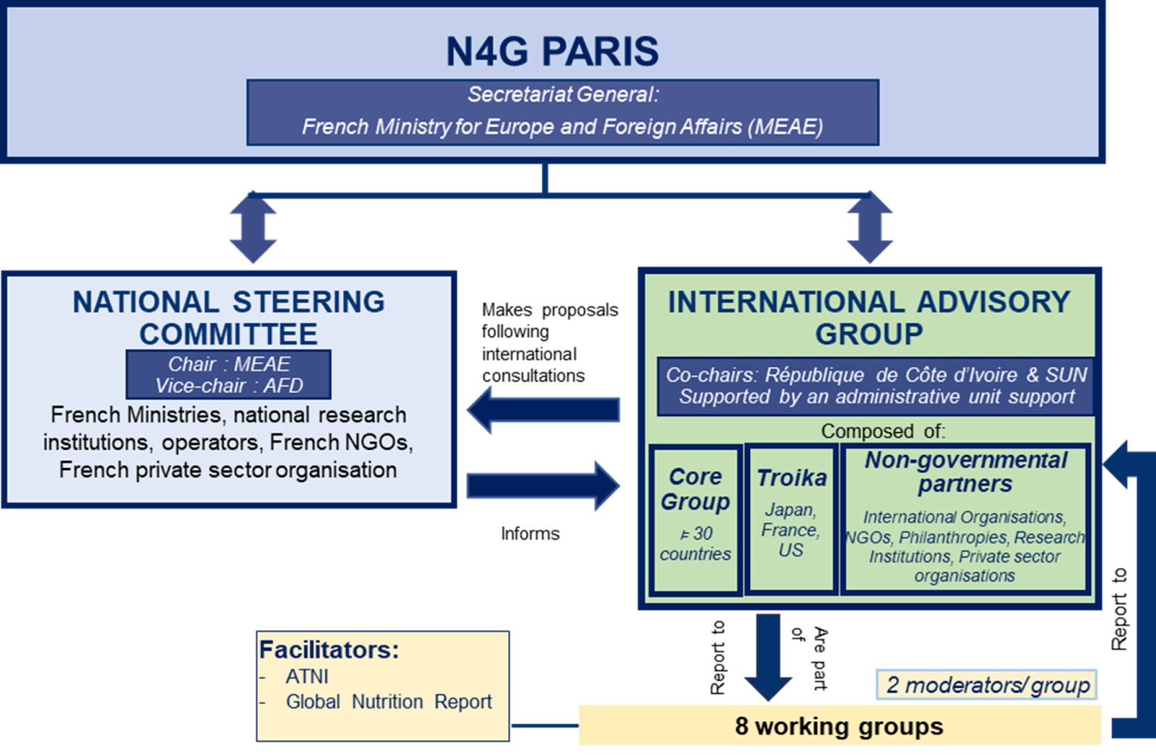
LESSONS-LEARNED ON THE ORGANIZATION
LESSONS-LEARNED ON THE ORGANIZATION
2. Build an inclusive and participative international governance structure
N4G Paris governance structure:
+ Inter-working group (set later on) to coordinate between thematic co-leads and on the mobilization

Slide 20
The IAG was a pulling force for the Summit.
Simple structure with Team France and Team World - great to have Cote d'Ivoire in co-lead of Team World. Good idea to get countries in different regions in charge of mobilizing neighboring countries although not sure in which extent it worked [...]. But overall a very participatory approach.
Appreciate the participative and consultative process; broad coalition allowed to reach out to a broad stakeholder group.
The Working Groups were particularly strong in developing an understanding of the emerging and important issues for nutrition and summarizing these into concise documents. The IAG was quite useful in sharing information with the Working Groups and providing a forum for raising some common issues, but more opportunities for communications across the Working Groups would have been beneficial.
Great to be inclusive to ensure all relevant stakeholder groups - including LMIC governments and civil society - are meaningfully engaged. However, the groups cannot be so large that it becomes hard to manage.

Slide 21
LESSONS-LEARNED ON THE ORGANIZATION
LESSONS-LEARNED ON THE ORGANIZATION
3. Plan strategically the mobilization of commitments
A good practice from N4G Paris was the high-level political mobilization and early engagement, guided by a mobilization strategy and priority targets, critical to secure commitments from the top pledgers. The critical leadership of the host country and particularly the N4G Paris Secretary General was acknowledged, in particular for the mobilization of public development banks and European actors. The identification of the roadmap in the vision from early on and key global events leading to the Summit was crucial in the process and requires to consider the agenda and decision-making cycles of major donors.
At N4G Paris, the crucial role of the SUN Movement, notably through TA providers (EU4SUN and C4N), in mobilizing Low and Lower-middle Income Countries countries and supporting commitment-making was broadly acknowledged and praised as a key factor of success.
Suggestions included to be clearer about the incentive for making ambitious commitments.
Consider building on existing N4G resources to update information about the commitment making process and recommendations.

Slide 22
In Paris 2025, it was amazing to see the work done by France and others to mobilize development banks and EU countries, and the work done by SUN (including though the donor-funded capacity strengthening workshops and consultants to support commitment making).
Having dedicated stakeholder group representatives was an effective way to mobilize the global community
The coordination of the commitment mobilization [...] is critical and needs to be well-functioning many months before the Summit so that communications are happening with potential commitment-makers early enough to go through political planning processes.
A recommendation to future hosts would be to use the existing vision, road map and guides (commitment and thematic guides) particularly around how commitments should be formulated. If the existing versions are used, then they can be shared earlier in the engagement process.
[recommendation] Working with the different constituencies and mobilisation groups that exist to support commitment makers to apply the existing tools is valuable.
Be clearer about rewards, and return of investments of making ambitious commitments
The upcoming N4G event will be a great opportunity to mobilize the global stakeholders and member states to work on the post-2030 agenda and national 5 to 10 years nutrition commitment post 2030.

Slide 23
LESSONS-LEARNED ON THE ORGANIZATION
LESSONS-LEARNED ON THE ORGANIZATION
4. Design the Summit to maximize engagement
While recognizing the rich content through the sessions format of thematic discussions and round table, there were suggestions that commitment announcements could be further integrated into the construct of the main program and include further stock-taking of past pledges (successes and challenges).
The program of side events provided opportunities for broader participation and deeper dives into specific topics. Efforts to select and merge side events were welcomed, and some suggested to condense them further to enhance engagement and focus, and avoid competition with the main sessions. While some called for a tighter Summit, it requires careful balancing with covering the depth and breadth of topics.
Ensuring time and space for networking is valued, and options that facilitates it are welcomed.
The "Village of Solutions“ was highlighted as a valuable initiative for networking and showcasing practical approaches (with some suggestions to have it closer to the venue to facilitate participation of high-level delegates attending the main conference).
The prominent space for the civil society and dedicated spaces for youth voices to be heard was deemed very positive. The CSO Pavillon was highlighted as crucial for diverse perspective and to provide a space for advocacy and a focus on accountability.

Slide 24
The programme covered relevant and important nexus topics (good thematic choice).
Side events were great and they enhanced the program as the main summit had limited capacity. In the future, I would suggest mixing thematic sessions with sessions where commitments are announced
I would advise running a tighter and more de-conflicted calendar of official events and side events (i.e. not having different events on the same topics / times)
CSO space is essential for N4G Summit and should be absolutely maintained.
The Village of Solutions was a wonderfully arranged event that could be recommended to other summits conferences. Smaller interactive side-sessions are also important for making connections.
Village des Solutions was a great initiative to present solutions and approaches for nutrition to the public.
[recommendation] a kind of exhibitions to be organized to share and exchange learning among member states on their commitments.

